Slide 1
Probability Distribution
A probability distribution is a description of how likely a random variable or set of random variables is to take on each of its possible states.
A probability distribution over discrete variables may be described using a probability mass function (PMF). We typically denote probability mass functions with a capital P.

Slide 2
Contd.
To be a probability mass function on a random variable x, a function P must satisfy the following properties
The domain of P must be the set of all possible states of x.
∀x ∈ x, 0 ≤ P(x) ≤ 1. An impossible event has probability 0 and no state can be less probable than that. Likewise, an event that is guaranteed to happen has probability 1, and no state can have a greater chance of occurring.

Slide 3
Contd.
. We refer to this property as being normalized .
Continuous random variables describes probability distributions using a probability density function (PDF).
To be a probability density function, a function p must satisfy the following properties

Slide 4
Contd.
The domain of must be the set of p all possible states of x.
∀x ∈ x, p(x) ≥ 0. Note that we do not require p(x) ≤ 1.
.
A probability density function p(x) does not give the probability of a specific state directly, instead the probability of landing inside an infinitesimal region with volume δx is given by p(x)δx.

Slide 5
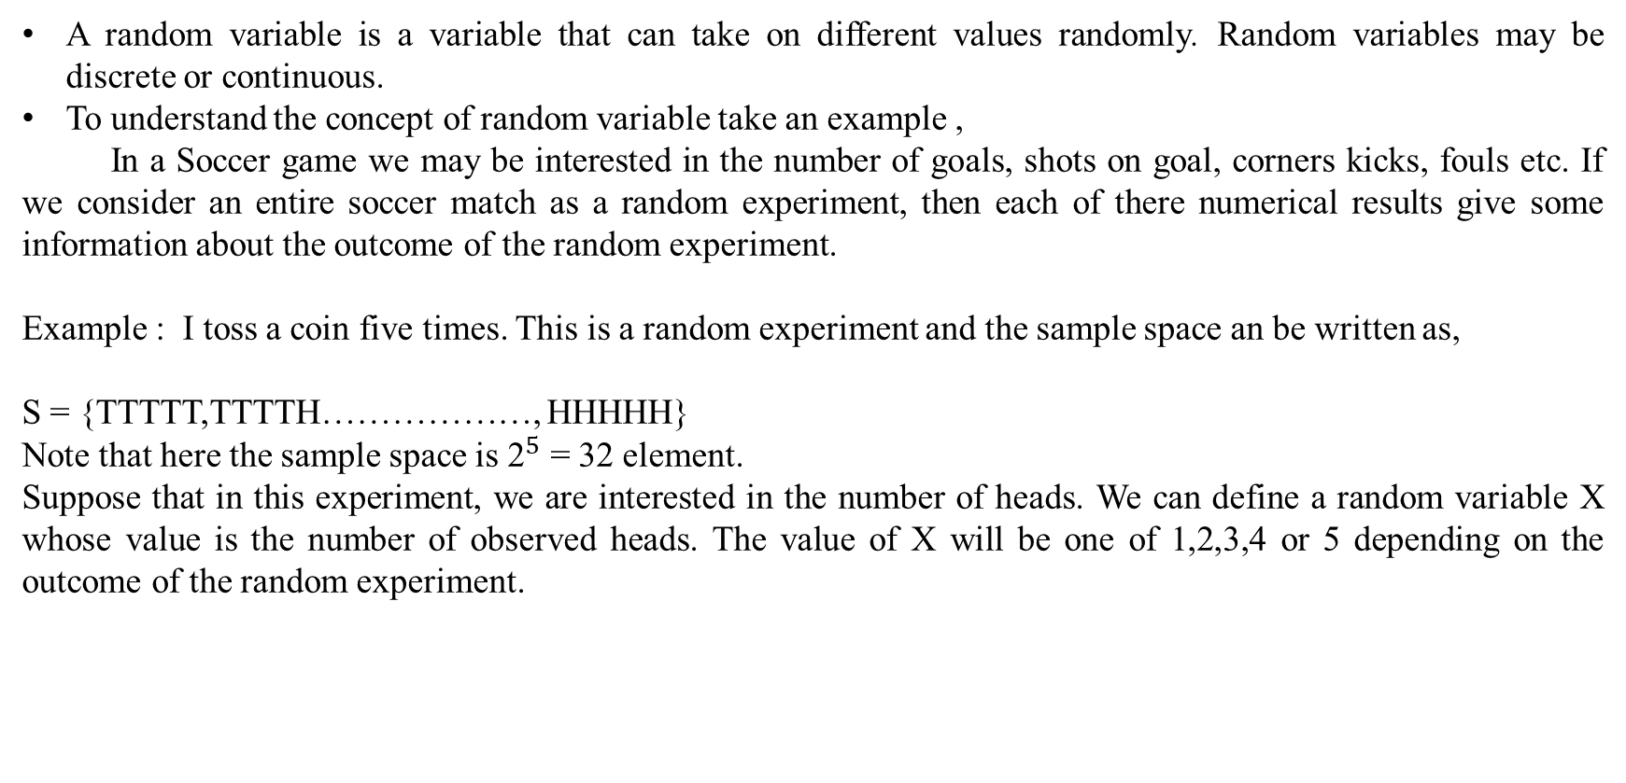
Random Variable
A random variable is a variable that can take on different values randomly. Random variables may be discrete or continuous.
To understand the concept of random variable take an example ,
In a Soccer game we may be interested in the number of goals, shots on goal, corners kicks, fouls etc. If we consider an entire soccer match as a random experiment, then each of there numerical results give some information about the outcome of the random experiment.
Example : I toss a coin five times. This is a random experiment and the sample space an be written as,
S = {TTTTT,TTTTH………………, HHHHH}
Note that here the sample space is ${\text{2}}^{5}$ = 32 element.
Suppose that in this experiment, we are interested in the number of heads. We can define a random variable X whose value is the number of observed heads. The value of X will be one of 1,2,3,4 or 5 depending on the outcome of the random experiment.

Slide 6
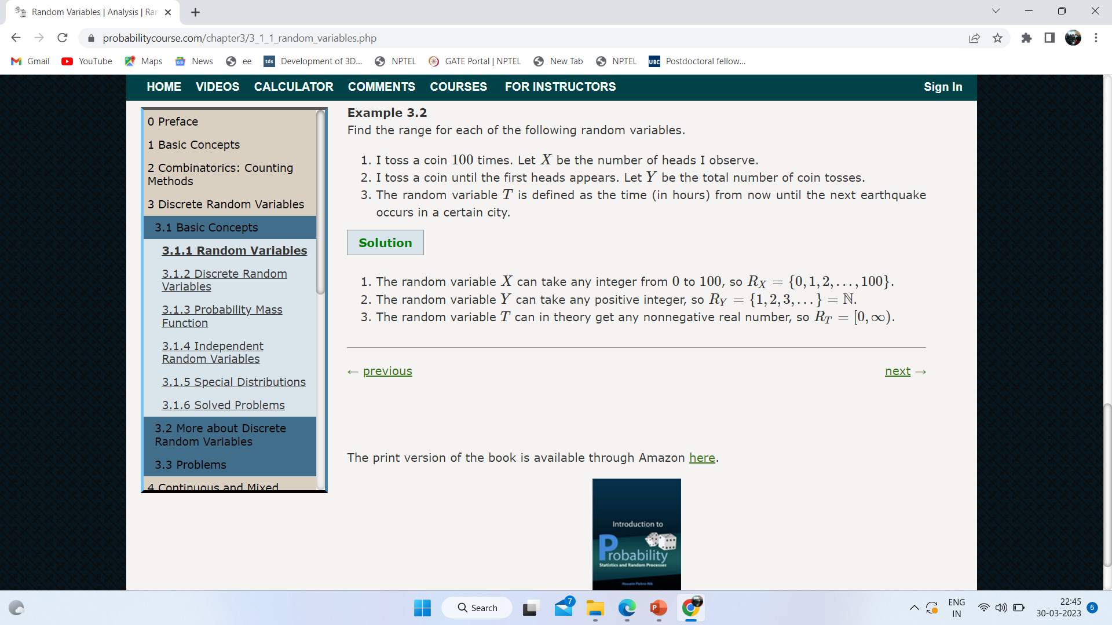

Slide 7
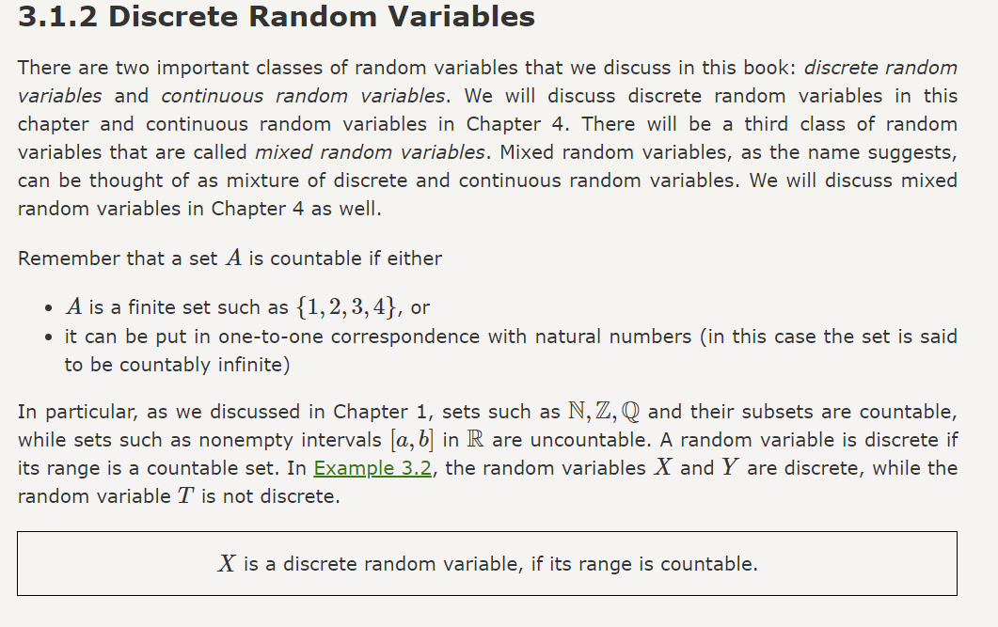

Slide 8
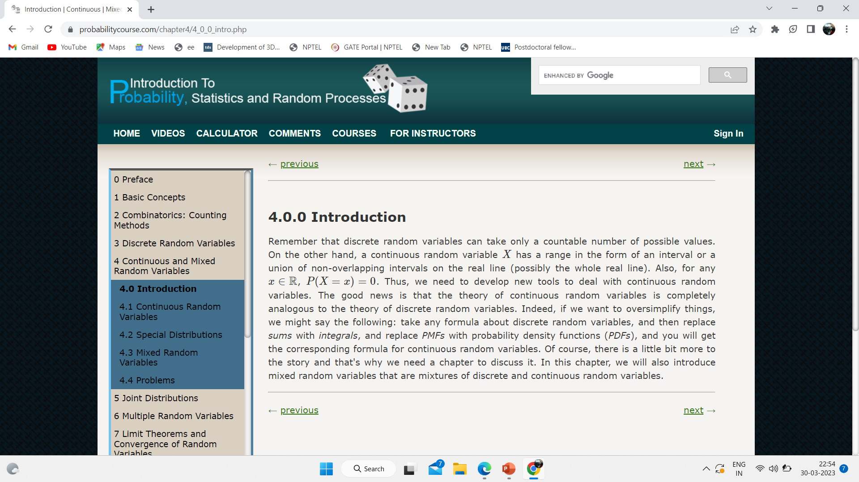
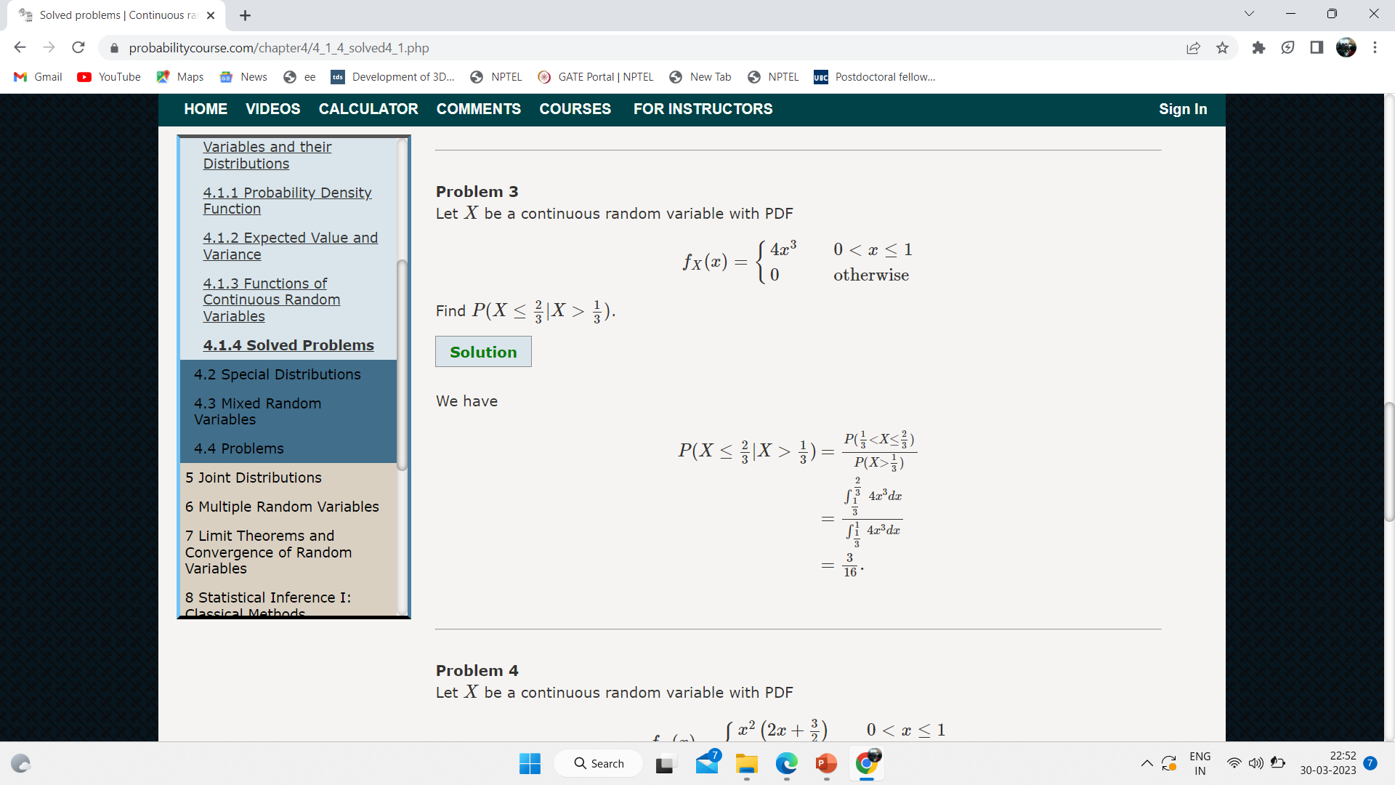
Continuous Random Variable

Slide 9
Marginal Probability and Conditional Probability
The probability distribution over the subset is known as the marginal probability distribution.
suppose we have discrete random variables x and y, and we know P(x, y). We can find P(x) with the sum rule
For a continuous variable summation is replaced over integration

Slide 10
Contd.
Conditional probability is the probability of some event, given that some other event has happened.
We denote the conditional probability that y = y given x = x as P (y = y | x = x).
So
The conditional probability is only defined when P( x = x) > 0.

Slide 11
Contd.
Chain rule or product rule of probability can be defined as
P(x⁽¹⁾, . . . , x^{(n)} ) = ( P ^{x(1)})Π^{n}_{i =2}P(x^{(i)} | x⁽¹⁾, . . . , x^{(i−1)}).
Two random variables x and y are independent if their probability distribution can be expressed as a product of two factors, one involving only x and one involving only y.
∀x ∈ x, y ∈ y, p(x = x, y = y) = p(x = x)p(y = y)

Slide 12
Contd.
Two random variables x and y are conditionally independent given a random variable z if the conditional probability distribution over x and y factorizes in this way for every value of z.
∀x ∈ x, y ∈ y, z ∈ z, p(x = x, y = y | z = z) = p(x = x | z = z)p(y = y | z = z).

Slide 13
Probability Distribution
The Bernoulli distribution is a distribution over a single binary random variable φ ∈(0,1).
P(x = x) = φ^{x}(1 − φ)^{1−x}
P(x=0)=1- φ
P(x=1)= φ
E(x)= φ
Var(x)= φ(1- φ)

Slide 14
Contd.
The most commonly used distribution over real numbers is the normal distribution, also known as the Gaussian distribution
The two parameters μ ∈ R and σ ∈ (0, ∞) control the normal distribution.
A normal distribution with μ=0 and σ=1 is called standard normal distribution.

Slide 15
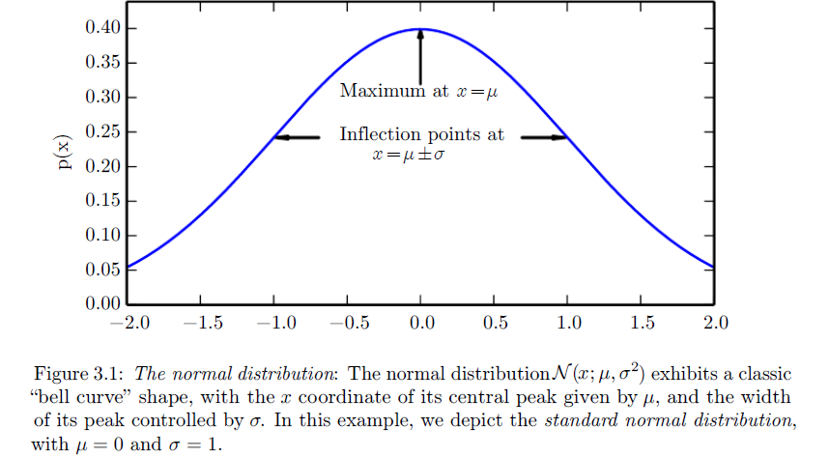
Normal Distribution

Slide 16
Bayes Theorem
Let E₁, E₂,…, E_{n} be a set of events associated with a sample space S, where all the events E₁, E₂,…, E_{n} have nonzero probability of occurrence and they form a partition of S. Let A be any event associated with S, then according to Bayes theorem

Slide 17
Entropy
The entropy value gives us the amount of uncertainty present in an entire probability distribution. It can be computed using the following relations
H(x)= -E[log(p(x)]
where E represents expectation of a variable.
If we have two separate probability distributions P ( x ) and Q(x) over the same random variable x , we can measure how different these two distributions are using the Kullback-Leibler (KL) divergence

Slide 18
Structured probabilistic models
Machine learning algorithms often involve probability distributions over a very large number of random variables. Using a single function to describe the entire joint probability distribution can be very inefficient (both computationally and statistically).
Instead of using a single function to represent a probability distribution, we can split a probability distribution into many factors that we multiply together.
For example, suppose we have three random variables: a, b and c. suppose that a influences the value of b and b influences the value of c, but that a and c are independent given b. We can represent the probability distribution over all three variables as a product of probability distributions over two variables
p(a, b, c) = p(a)p(b | a)p(c | b)

Slide 19
Contd.
These factorizations can greatly reduce the number of parameters needed to describe the distribution
We can describe these kinds of factorizations using graphs.
When we represent the factorization of a probability distribution with a graph, we call it a structured probabilistic model or graphical model.
There are two main kinds of structured probabilistic models: directed and undirected.
Both kinds of graphical models use a graph G in which each node in the graph corresponds to a random variable, and an edge connecting two random variables means that the probability distribution is able to represent direct interactions between those two random variables.

Slide 20
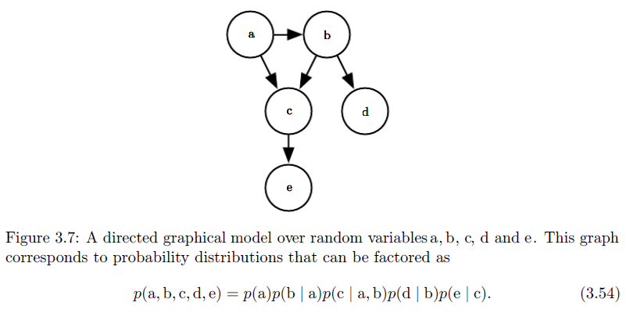
Contd.

